Slide 1
LPC214X
The LPC2141/2/4/6/8 microcontrollers are based on a 32/16 bit ARM7TDMI-S CPU .
With real-time emulation and embedded trace support, that combines the microcontroller with embedded high speed flash memory ranging from 32 kB to 512 kB.
A 128-bit wide memory interface and a unique accelerator architecture enable 32-bit code execution at the maximum clock rate.
For critical code size applications, the alternative 16-bit Thumb mode reduces code by more than 30 % with minimal performance penalty.

Slide 2
Due to their tiny size and low power consumption, LPC2141/2/4/6/8 are ideal for applications where miniaturization is a key requirement, such as access control and point-of-sale.
A blend of serial communications interfaces ranging from a USB 2.0 Full Speed device, multiple UARTs, SPI, SSP to I2Cs, and on-chip SRAM of 8 kB up to 40 kB.
Various 32-bit timers, single or dual 10-bit ADC(s), 10-bit DAC, PWM channels and 45 fast GPIO lines with up to nine external interrupt pins make these microcontrollers particularly suitable for industrial control and medical systems.

Slide 3
Features of LPC214X
16/32-bit ARM7TDMI-S microcontroller
8 to 40 kB of on-chip static RAM and 32 to 512 kB of on-chip flash program memory.
128 bit wide interface/accelerator enables high speed 60 MHz operation.
In-System/In-Application Programming (ISP/IAP) via on-chip boot-loader software.
Single flash sector or full chip erase in 400 ms and programming of 256 bytes in 1 ms.
Embedded ICE RT and Embedded Trace interfaces offer real-time debugging with the on-chip Real Monitor software and high speed tracing of instruction execution.
USB 2.0 Full Speed compliant Device Controller with 2 kB of endpoint RAM.
In addition, the LPC2146/8 provide 8 kB of on-chip RAM accessible to USB by DMA.

Slide 4
One or two 10-bit A/D converters provide a total of 6/14 analog inputs, with conversion times as low as 2.44 micro s per channel.
Single 10-bit D/A converter provides variable analog output.
Two 32-bit timers/external event counters (with four capture and four compare channels each), PWM unit (six outputs) and watchdog.
Low power real-time clock with independent power and dedicated 32 kHz clock input.
Multiple serial interfaces including two UARTs (16C550), two Fast I2C-bus (400 kbit/s), SPI and SSP with buffering and variable data length capabilities.
Up to nine external interrupt pins available.

Slide 5
60 MHz maximum CPU clock available from programmable on chip PLL.
On-chip integrated oscillator operates with an external crystal in range from 1 MHz to 30 MHz and with an external oscillator up to 50 MHz.
Power saving modes include Idle and Power-down.
Individual enable/disable of peripheral functions as well as peripheral clock scaling for additional power optimization.
Processor wake-up from Power-down mode via external interrupt, USB, Brown-Out Detect (BOD) or Real-Time Clock (RTC).
Single power supply chip with Power-On Reset (POR) and BOD circuits:
CPU operating voltage range of 3.0 V to 3.6 V

Slide 6

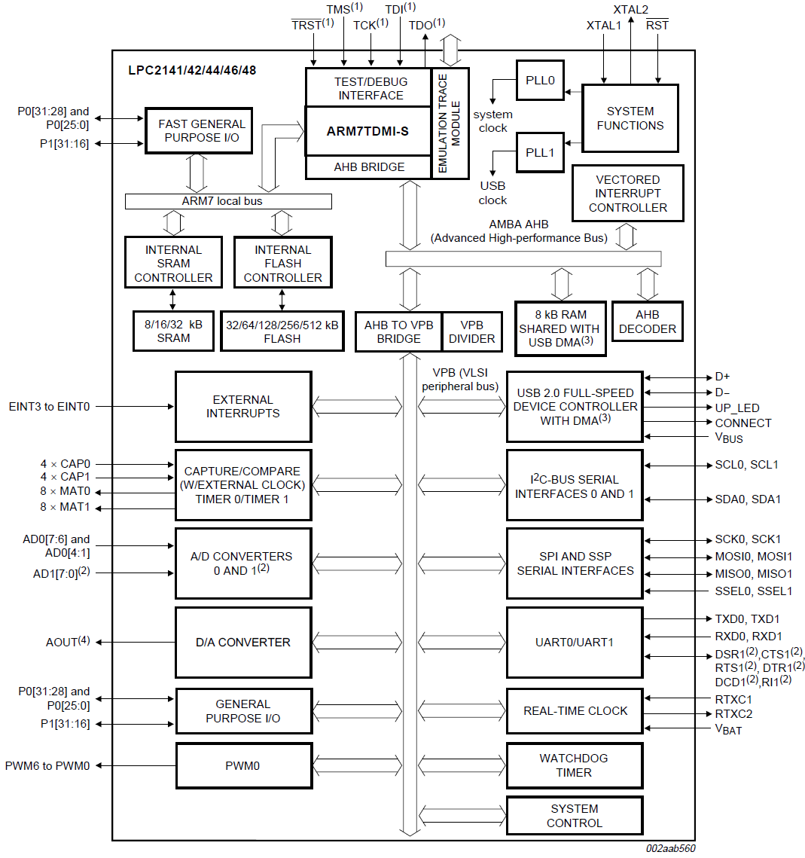

Slide 7
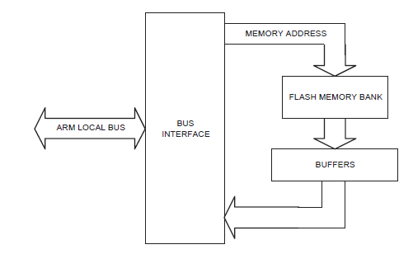
Memory Accelerator Module (MAM)

